Slide 1
SERVICE ON WHEELS

Slide 2

ARE YOU STUCK ?
Be it day or night , we find you, solve the bike problem and get you moving again…

Slide 3
INTRODUCTION
Earlier motorists were able to carry out minor repairs themselves, but as the complications in automobiles increased, this became more difficult to carry out successfully.
If your motorcycle breaks down due to a minor mechanical or electrical fault an immediate repair on the spot is deemed if possible, service on wheels shall assist the user by arranging for a mechanic to reach the breakdown location.
However, the cost of material and spare parts, if required, to repair the motorcycle on the spot and any other incidental conveyance to obtain such material and spare parts, will have to be borne by the user.
We have used the following online API’s in this app : Map Activity, Maven and StickySwitch Repository on GitHub.
This project involves two apps , one for the MECHANIC and the other for the CLIENT.

Slide 4
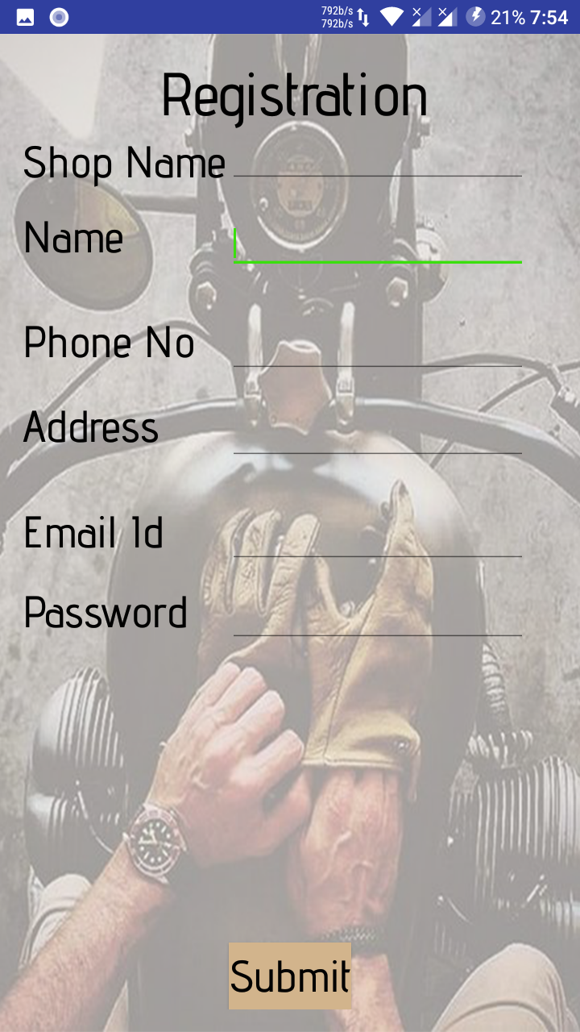
MECHANIC REGISTRATION
Registration Process
Mechanic has to submit the necessary documents in the office.
Documents will be verified.
Admin registers the mechanic in the app.

Slide 5
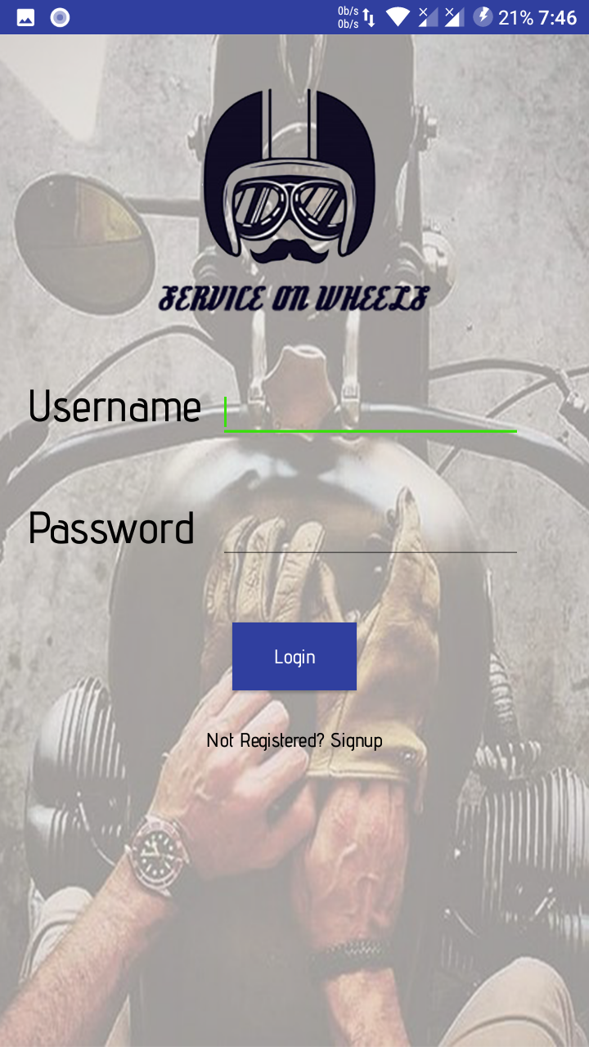
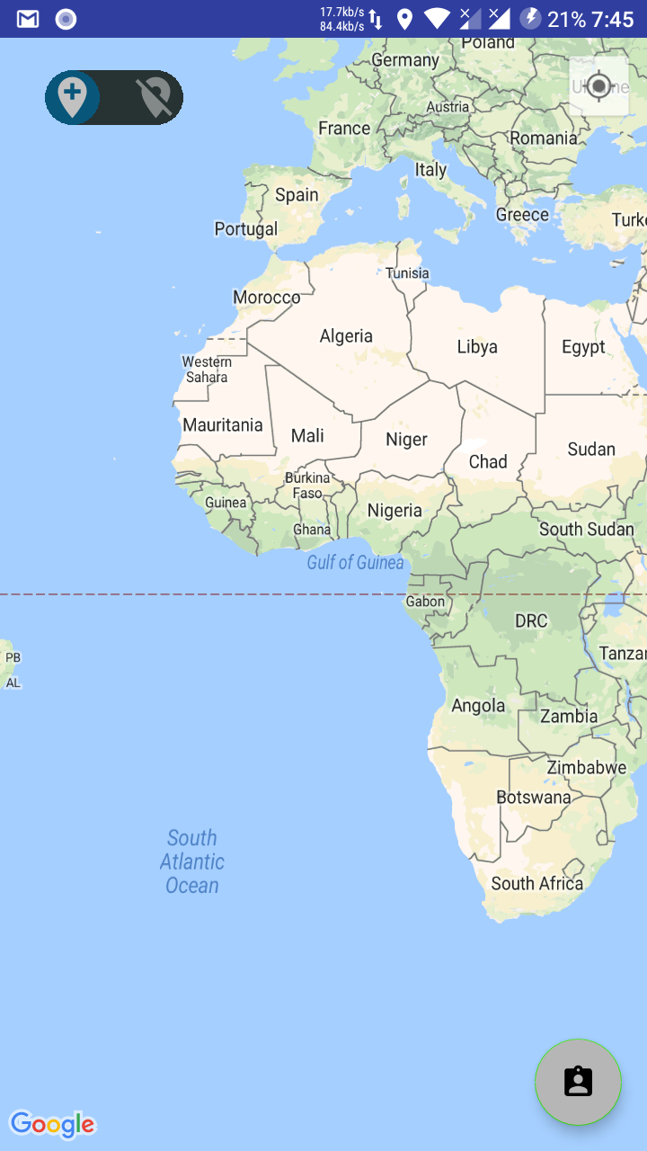
MECHANIC
LOGIN
SUCCESSFUL LOGIN

Slide 6
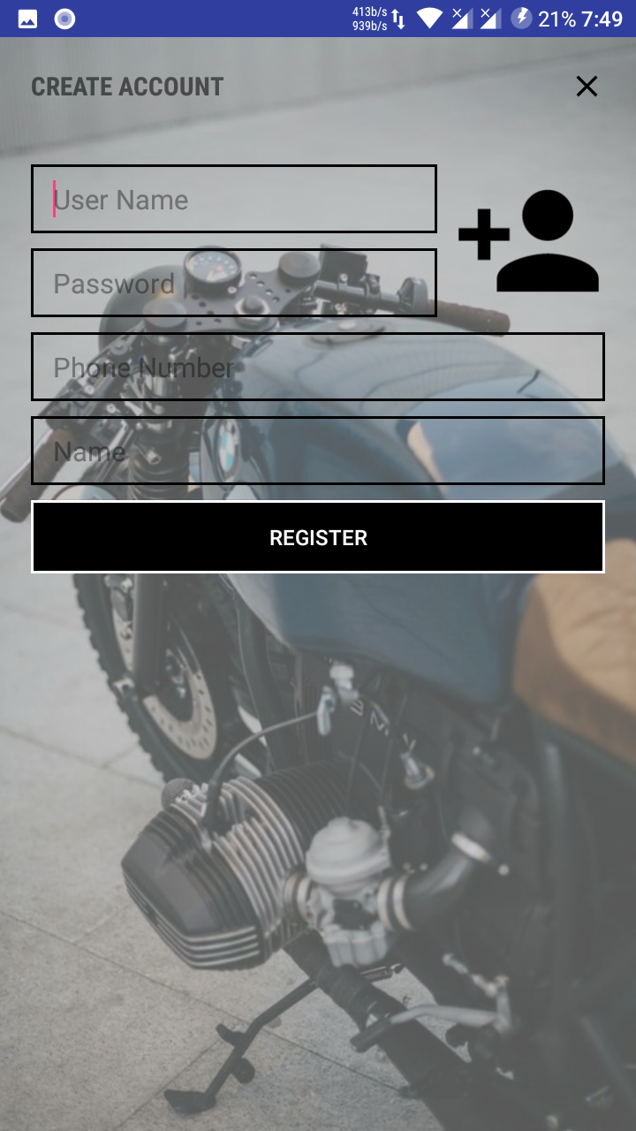
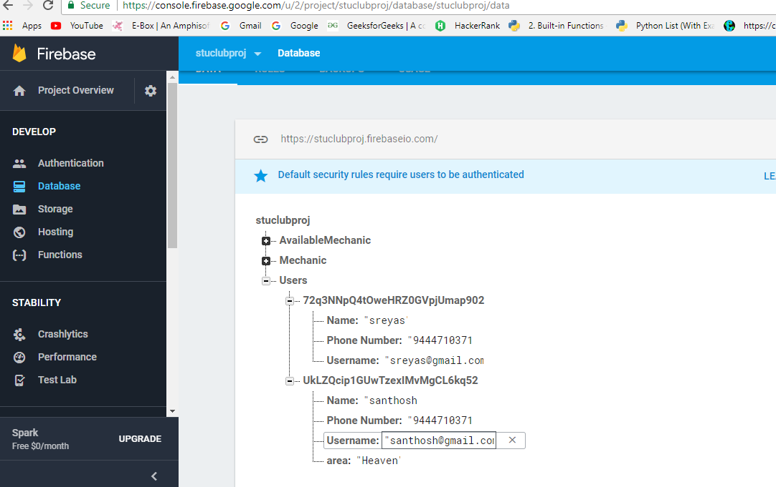
USER REGISTRATION
REGISTRATION
DATABASE

Slide 7

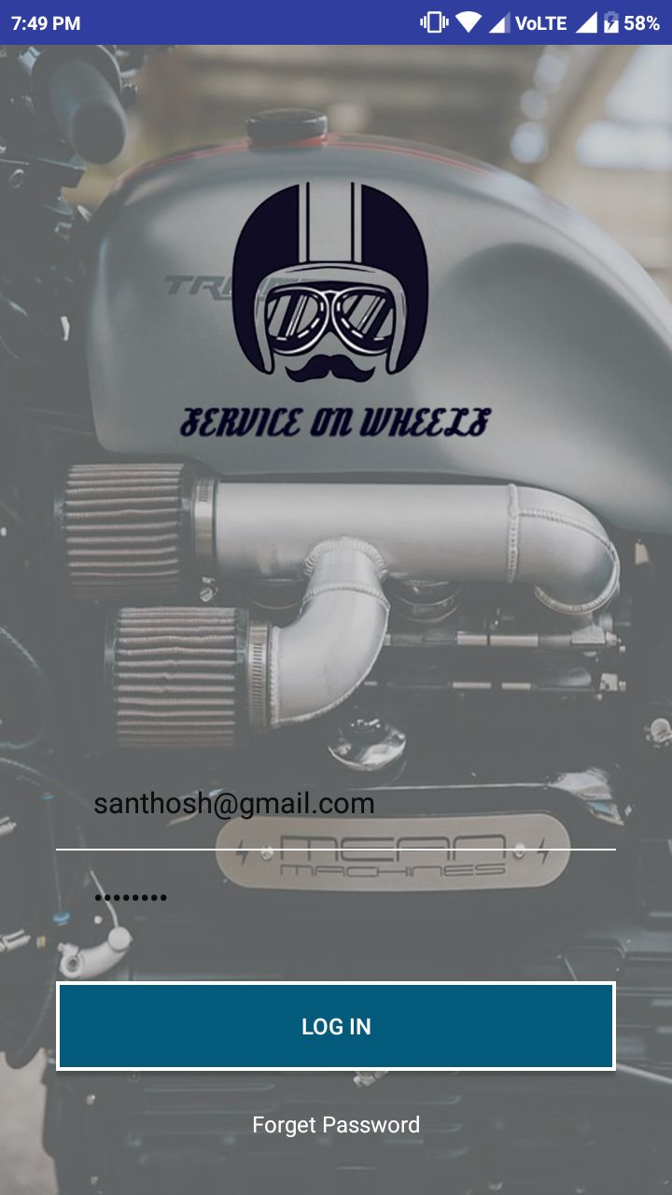
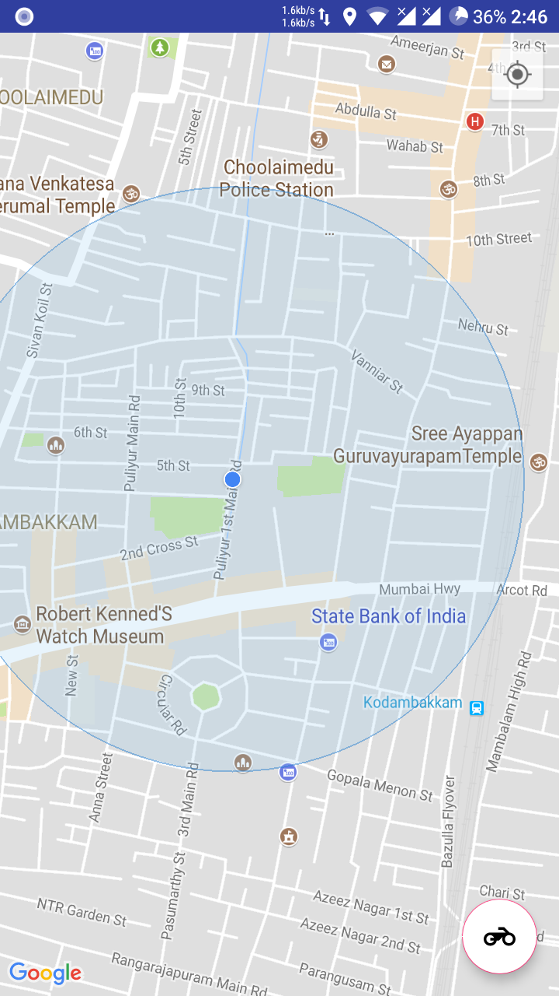
USER LOGIN
SPLASH SCREEN
LOGIN PAGE
DISPLAYS USERS LOCATION

Slide 8
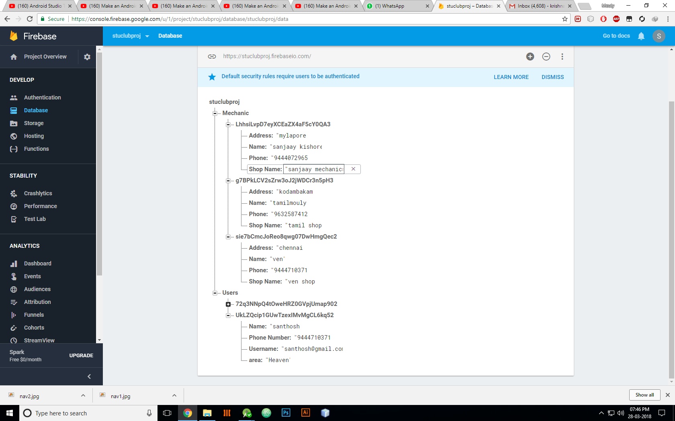
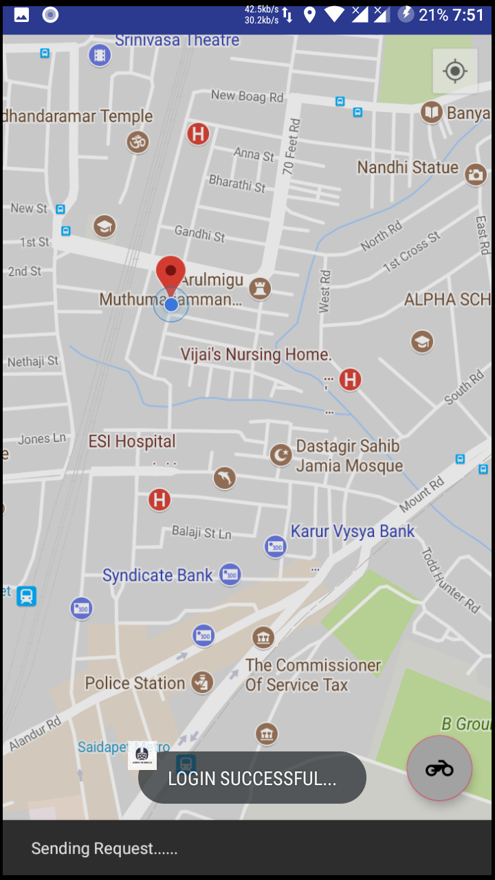
USER
INITIAL DATABASE
After selecting the bike icon

Slide 9
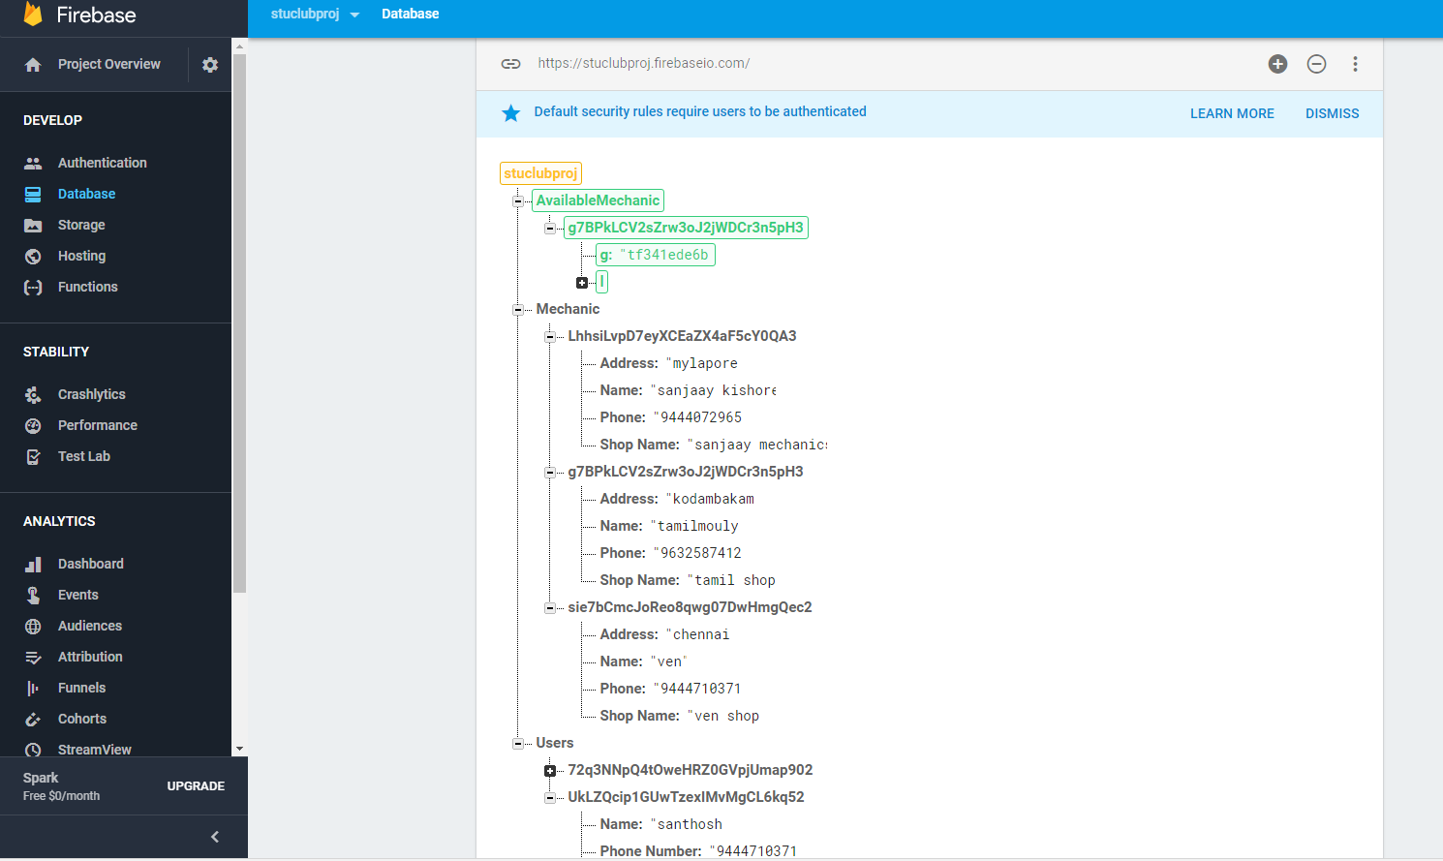
MECHANICS AVAILABLE FOR SERVICE

Slide 10
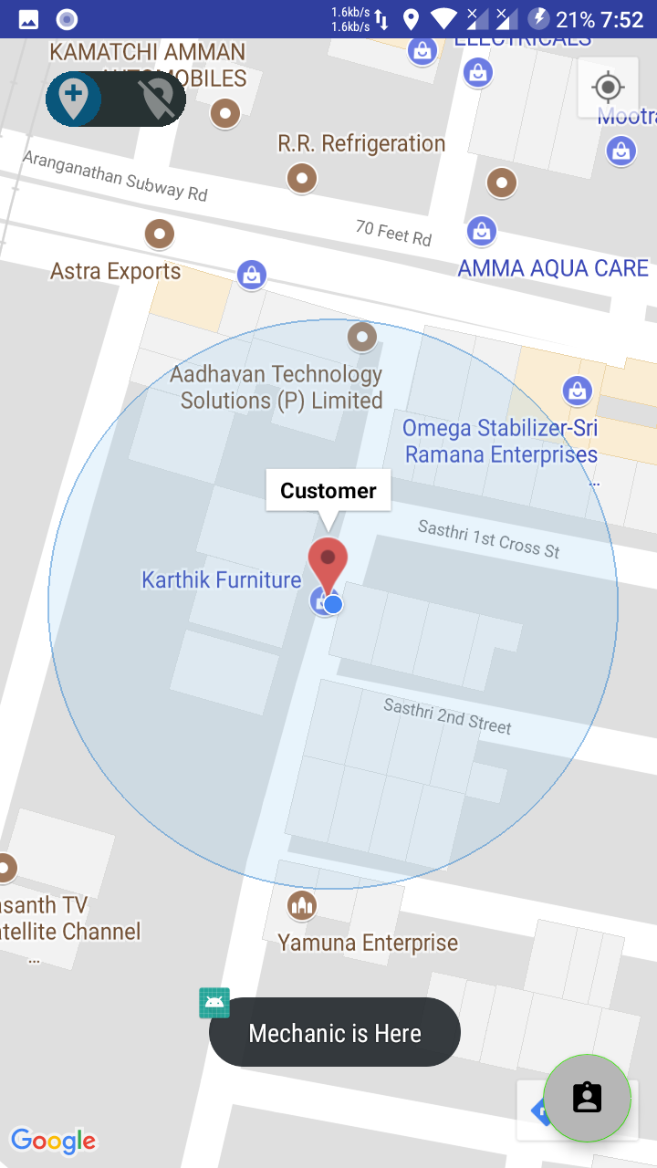
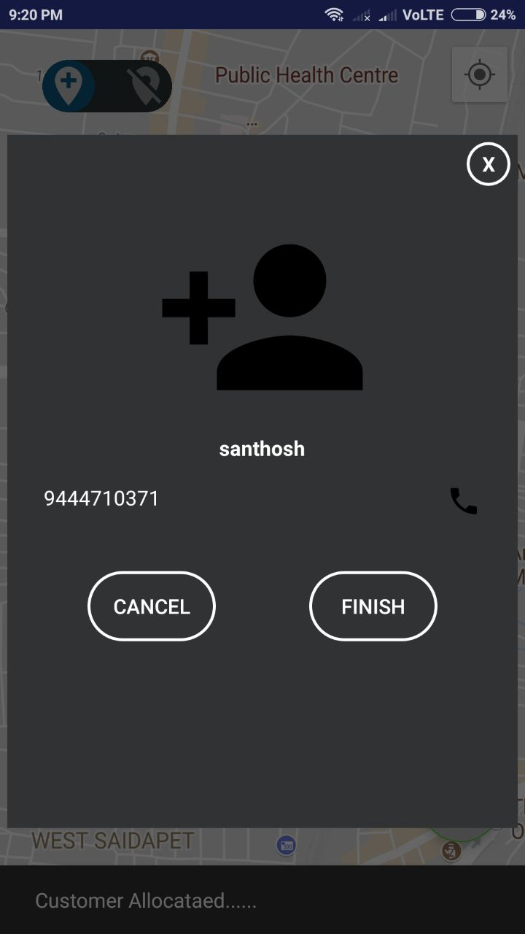
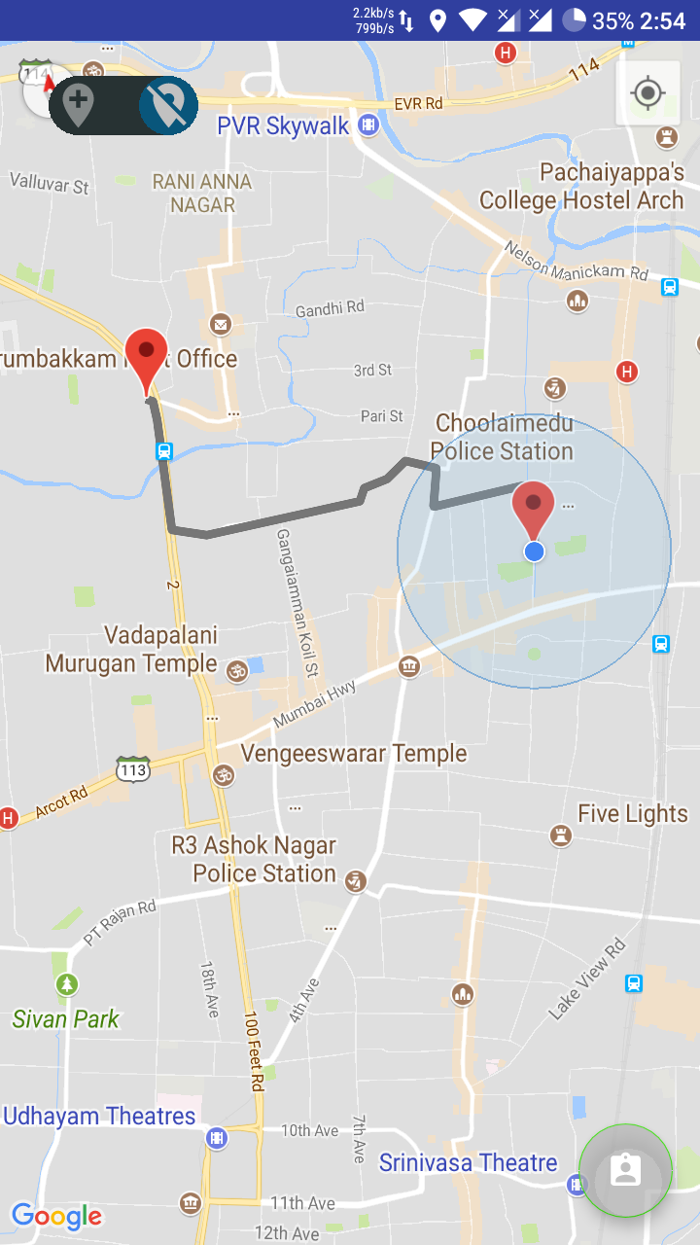
ROUTE IDENTIFICATION
The Mechanic closest to the user’s location is selected
Mechanic can view user details
Route

Slide 11
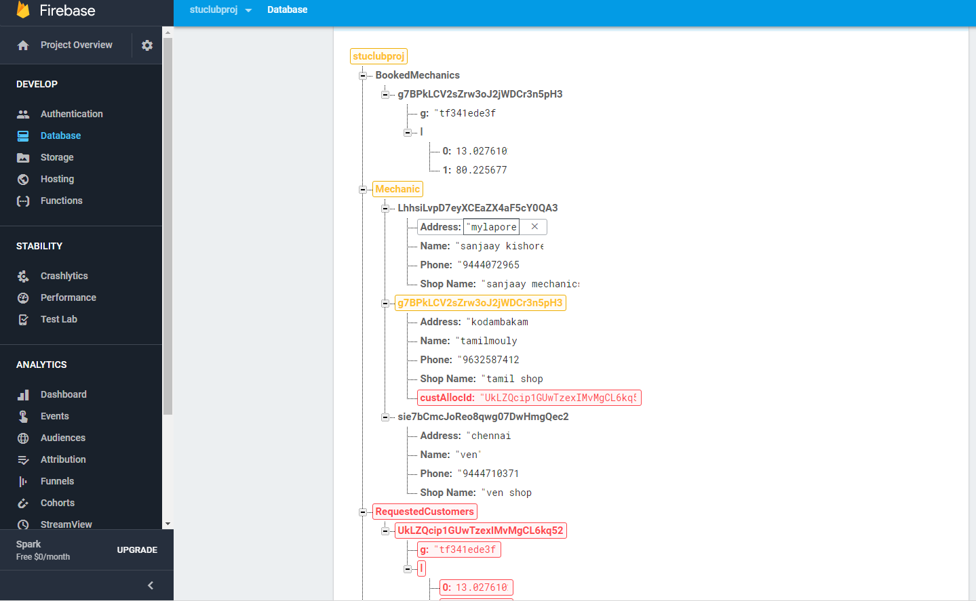
USER AND MECHANIC DETAILS IN DATABASE
After completion of the work

Slide 12
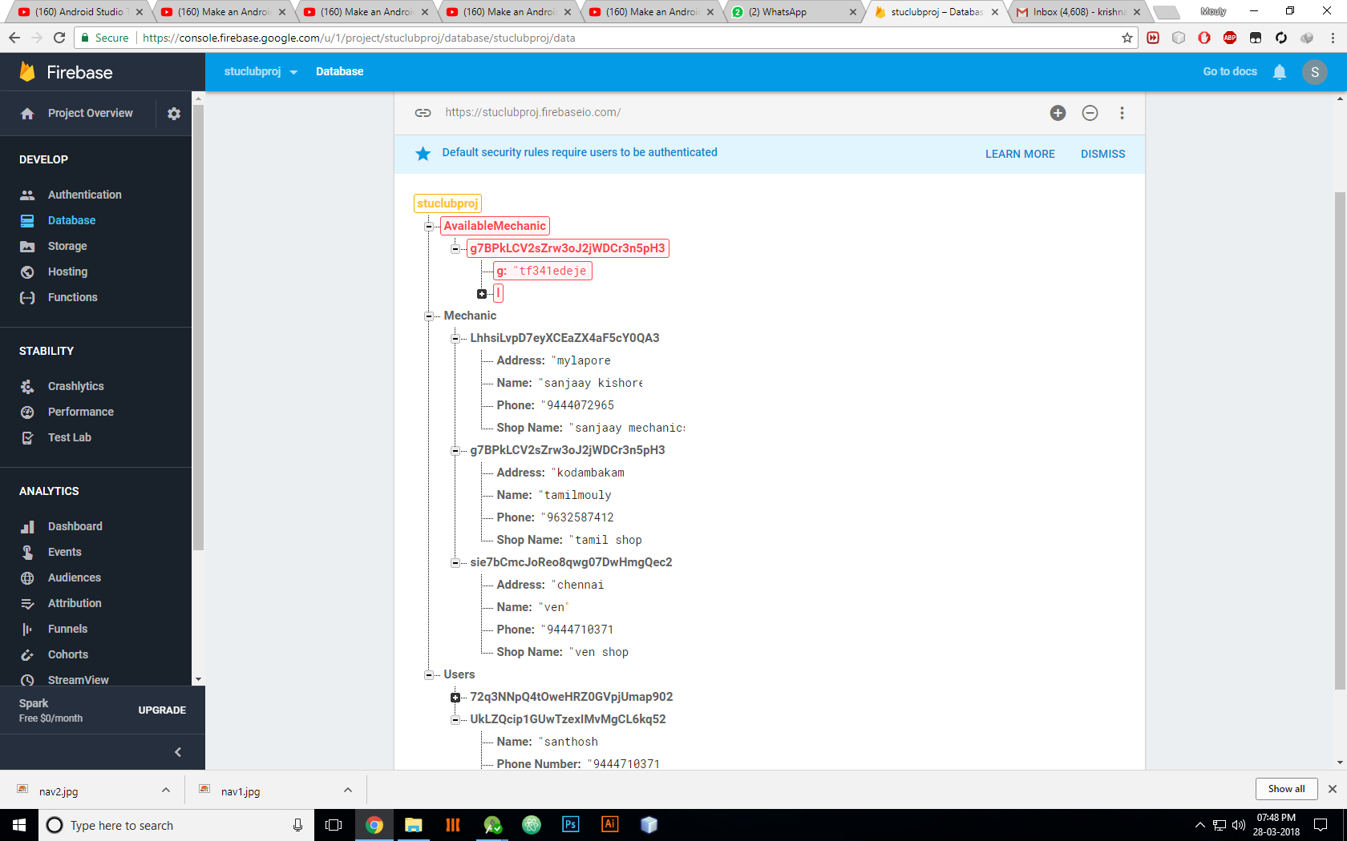
MECHANIC DENIES SERVICE
In case , the mechanic denies service, the details of the next available mechanic in the user’s locality will be displayed to the user.

Slide 13
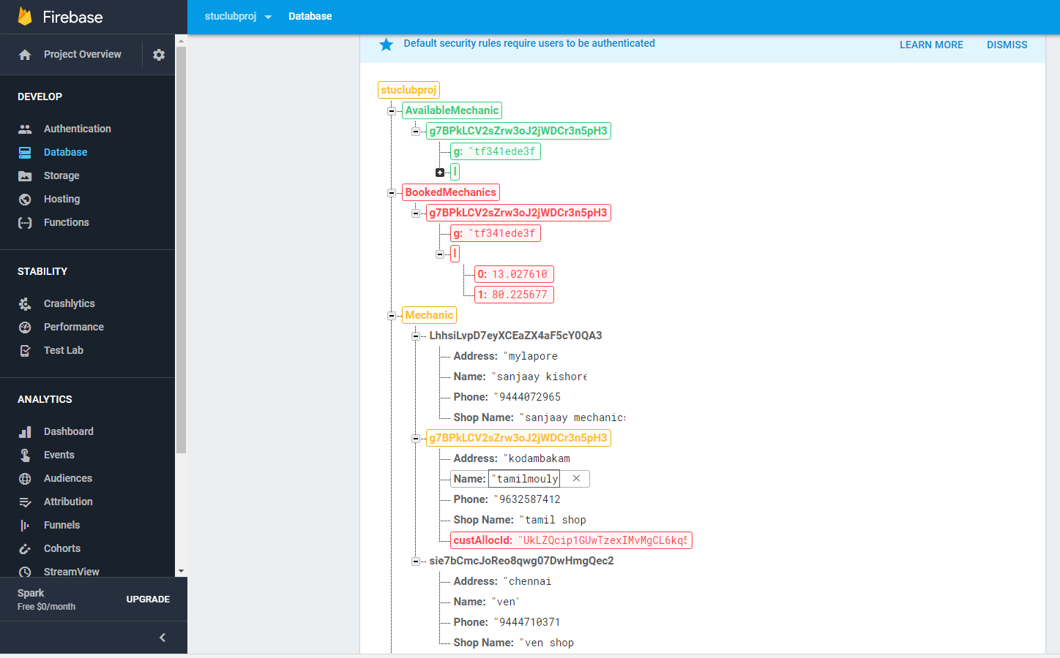
CUSTOMER CANCELS REQUEST

Slide 14
BENEFITS
Faster access to mechanics.
24*7 accessibility.
More secured.
Saves time
Easy to use
Ubiquitous

Slide 15
FUTURE ENHANCEMENTS
Customer calling
Review Systems
Payments

